Slide 1
Language Design
Syntax
Abhijit A M
abhijit.comp@coep.ac.in

Slide 2
What is Syntax
Arrangement of words in a sentence
  To show their relationship
  Rules like “I ate apple” and not “ate I apple”
In Programming languages
  How to write X equals addition of Y and Z ?
  X = Y + Z or
  Y Z + X =

Slide 3
Syntax is not enough
Meaning for each syntax
  Called Semantics
Syntax is “looks”, Semantics is “behavior” of a program
Different Syntax, same semantics
  C: i = a + b
  Shell: i=`expr $a + $b`
Same Syntax, different semantics
  C: if(a=b) → assign a = b, and then value of a is condition
  Pascal: if (a=b) → check if a is equal to b

Slide 4
Language Translation
Tokens
main() {
A = B + C + D
}
Main,keyword {,delimiter A, identifier =, operator B, identifier +,operator C, identifier +,operator D, identifier
Lexical Analysis
Syntax Analysis
=
R1 = B
R1 = R1 + C
T1 = R1
R1 = T1
R1 = D + R1
T2 = R1
R1 = T2
A = R1
Optimized Code
R1 = B
R1 = R1 + C
R1 = D + R1
A = R1
A
+
Optimization
Parse Tree
+
B
+
T 1 = B + C
T2 = T 1 + D
A = T2
C
Code Generation
Semantic Analysis
D
Machine Code
Intermediate Code

Slide 5
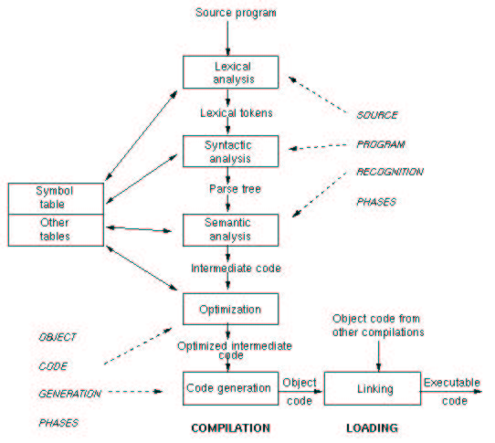
Process of language translation

Slide 6
Use GCC to understand the language translation
gcc --save-temps a.c
  Generates a.s, a.i, a.o
  a.i is the output of pre-processor
  a.s is the assembly code
  a.o is the machine code before linking is done
Also try

Slide 7
Have you written a translator ?
Yes
  Infix to postfix conversion !
  Input language:Infix
  Output language: Postfix

Slide 8
Syntax Design Criteria
Readability
Writeability
Ease of verifiability
Ease of translation
Lack of ambiguity

Slide 9
Readability
Program should be “self-documentary”
For reliability, language should have
  Statement format like natural statements
  Structured statements
  Many keywords
  Comments within code
  Long names for variables
  …
Bad programming can still kill readability !
Readability can be enforced
  e.g. COBOL

Slide 10
A Sample COBOL program
READ-DATA
READ INP-DATA AT END GO TO PRINT-LINE.
ADD 1 to COUNT.
ADD PRICE TO TOT.
MOVE PRICE TO PRICE-OUT.
MOVE ITEM TO ITEM-OUT.
WRITE RESULT-LINE FROM ITEM-LINE.
GO TO READ-DATA.
PRINT LINE.

Slide 11
Writability
Readability and Writeability often conflict
Writeability requires
  Concise and regular syntactic structures
C
  Good writability
  Small statements, big meaning
  for(;;);

Slide 12
Verifiability
Understanding by reading and re-reading
Proving a program to be correct, formally!
Verification theory area

Slide 13
Ease of translation
COBOL extremely difficult to translate
Less features → ease of translation

Slide 14
Ambiguity
We just don't serve Wadapav, We serve people also !

Slide 15
Ambiguity
If <boolean_expression> then
if <boolean_expression2> then statement1
else statement2
Solution: begin -end OR { }
If <boolean_expression> then begin
if <boolean_expression2> then statement1 end
else statement2
FORTRAN
  A(I,J)
  Function call A or 2-D array with indices i,j ?

Slide 16
Syntactic Elements
Character Set
  Earlier: 8 bit , so 256 characters → alphabets lower and upper case, 10 digits, punctuation symbols
  Now: Internationalization support → Unicode 16 bit
    Support for Greek, Hebrew, Arabic, Devnagari, Chinese, etc.
Identifiers
  Length of a variable name
  Early BASIC: Single letter and digit

Slide 17
Syntactic Elements
Operator Symbols
  +, -, ...
  PLUS (LISP)
  ** .EQ. (FORTRAN)
Keywords and reserved words
  Keyword : identifier which has fixed meaning
  Reserved words : keywords which can't be used as user defined variables
    Most languages today use reserved words
Noise words
  Words that improve readability, but no additional meaning
If <expression> then; begin <statements>; end
then is redundant

Slide 18
Syntactic Elements
Comments
  Separate comment lines, e.g. BASIC
  REM this is a comment
  Special markers, e.g. C
  /* this is a comment
  */
  Begin anywhere but end at line,e.g. C++
  i++; // this is a comment
Blanks /Spaces
  Enable indentation
  Python → Compulsory indentation

Slide 19
Syntactic Elements
Delimiters and brackets
  { } , begin end
  [ ], ( )
  Enhance readability
  Help remove ambiguities
Free and fixed field format
  Free field : Write anywhere on the line. Norm today
  COBOL: Begin each line at a specified spacing
Expressions
Statements
  Assignment, if-then-else, for, while, …

Slide 20
Defining/Describing the Syntax
Grammar: Set of rules that specify the sequence of characters (lexical items) that form a legal program
Need a notation for the same: BNF (Backus Naur Form)
  Since 1958

Slide 21
BNF Grammars
Consider English
Simple sentence
Subject Verb Object
She ate food
Interrogative sentence
Auxiliary verb Subject Predicate ?
Did She Eat Food ?
Suppose this is our “smallEnglish” language

Slide 22
BNF: How to write a grammar ?
Nonterminal: A finite set of symbols:
<sentence> <subject> <predicate> <verb> <article> <noun>
Terminal: A finite set of symbols: the, boy, girl, ran, ate, cake
Start symbol: One of the nonterminals:
<sentence>

Slide 23
BNF Grammar for our language
<sentence> ::= <simple> | <Interrogative>
<simple>::= <subject> <verb> <object>
<interrogative> ::= <aux verb> <subject>
<predicate>
<predicate>::= <verb> <object>
<subject> ::= she | he
<verb> ::= ran | ate | eat | run
<object> ::= food
<aux verb> ::= did

Slide 24
Another BNF
Rules (productions): A finite set of replacement rules:
<sentence> ::= <subject> <predicate>
<subject> ::= <article> <noun>
<predicate>::= <verb> <article> <noun>
<verb> ::= ran | ate
<article> ::= the
<noun> ::= boy | girl | cake
Replacement Operator: Replace any nonterminal by a right hand side value using any rule (written )

Slide 25
From Grammar to Programs
Derivation
  Process of applying rules in turn to get all terminal symbols

Slide 26

Derivation
A derivation is a sequence of sentential forms starting from start symbol.
Derivation trees:
  Grammar: B -> 0B | 1B | 0 | 1
  Derivation: B => 0B => 01B => 010
From derivation get parse tree

Slide 27
Examples
<sentence> => <subject> <predicate> First rule
=> <article> <noun> <predicate> Second rule
=> the <noun> <predicate> Fifth rule
.. => the boy ate the cake
Also from <sentence> you can derive
the cake ate the boy
Correct syntax does not imply correct semantics
This BNF rule also written with equivalent syntax:
A -> BC

Slide 28
Language
A language generated by grammar G (written L(G)) is the set of all strings over the terminal alphabet (i.e., sentences) derived from start symbol.
Any string derived from the start symbol is a sentential form.
Sentence: String of terminals derived from start symbol by repeated application of replacement operator
That is, a language is the set of sentential forms containing only terminal symbols.

Slide 29
Finite and infinite language
Recursive rules
  A → B | AB
  B → 0 | 1
Finite language
  If the no. of valid strings/sentential forms Is limited
Infinite language
  Generates infinite strings
Recursive rules lead to infinite languages

Slide 30
Uniqueness of derivation
Derivations are not necessarily unique
Consider grammar for sequences of balanced parentheses
S -> SS | (S) | ()
S => SS => (S)S => (())S => (())()
S => SS => S() => (S)() => (())()
Different derivations give the same parse tree

Slide 31
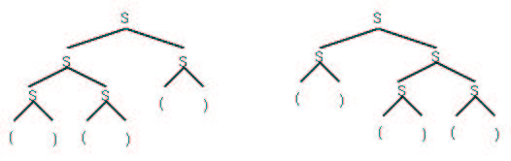
Language ambiguity in terms of grammar
Another Example
S => SS => SSS => ()SS => ()()S => ()()()
S => SS => SSS => SS() => S()() => ()()()
A grammar is ambiguous if some sentence has 2 distinct parse trees.
We desire unambiguous grammars to understand semantics.

Slide 32
Removing ambiguity
S → SS | 0 | 1
The string 001 can be derived in > 1 ways
S → SS → 0S → 0SS → 00S → 001
S → SS → S1 → SS1 → 0S1 → 001
Lets rewrite the grammar
T → 0T | 1 T | 0 | 1

Slide 33
Grammar for assignment statement
<assignment statement> ::= <variable> = <arithmetic expression>
<arithmetic expression> ::= <term>
| <arithmetic expression> + <term>
| <arithmetic expression> - <term>
<term> ::= <primary> | <term> * <primary>
| <term> / <primary>

Slide 34
Grammar for assignment statement
<primary> ::= <variable> | <number>
| (<arithmetic expression>)
<variable>::= <identifier>
| <identifier><subscript list>
<subscript list>::=
[arithmetic expression>] |
<subscript list> [arithmetic expression>]

Slide 35
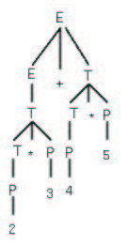
Expression Trees

Slide 36
Extended BNF
This is a shorthand notation for BNF rules. It adds no power to the syntax,only a shorthand way to write productions:
| - Choice ( ) - Grouping
{}* - Repetition - 0 or more {}+ - Repetition - 1 or more
[ ] - Optional
Example: Identifier - a letter followed by 0 or more letters or digits:
Extended BNF Regular BNF
I -> L { L | D }* I -> L | L M
L -> a | b |... M -> CM | C
D -> 0 | 1 |... C -> L | D
L -> a | b |...
D -> 0 | 1 |...

Slide 37
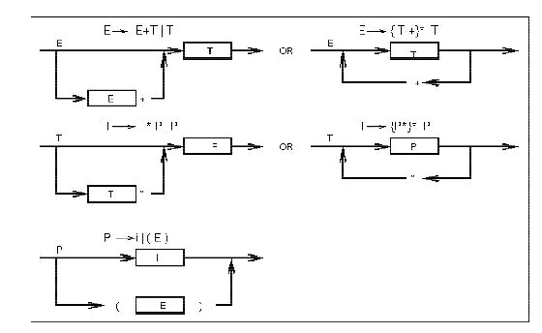
Syntax Charts
Another way of specifying grammar

Slide 38
YACC
Yet Another Compiler Compiler
  The problem of checking for “correct syntax” is already almost solved.
  YACC: Tool to generate a Syntax analyzer.
    Input: Grammar
    Output: A program that checks whether a given code-file is in accordance with the given grammar.
  You need to write only the grammar and error messages

Slide 39
LABORATORY

Slide 40
Make utility
Compiling many files together
cc -c a.c
cc -c b.c
cc -c c.c
cc a.o b.o c.o
Cc a.c b.c c.c is equivalent to all of above together
If only a.c has changed then
cc -c a.c
cc a.o b.o c.o
No. of steps increase and no. of files increase

Slide 41
EXTRA SLIDES

Slide 42
Describing Terminal Symbols
Tokens have a simple structure
E.g. identifier → letter followed by letters
Simpler notation and model to realize them
Regular Grammar → Special case of BNF when each rule is of the form
<nonterminal> → <terminal> <nonterminal> | <terminal>

Slide 43
Regular Grammar
A → 0A | 1 A | 0
All binary strings ending in a 0
A model to realize them is called Finite State Automata (FSA)

Slide 44
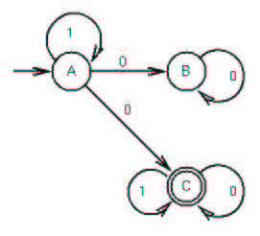
FSA

Slide 45
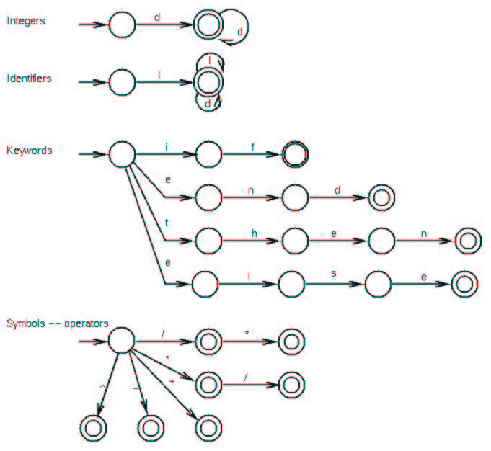
FSA for various tokens

